Slide 1
Workshop
State of Washington
Mar 14, 2022

Slide 2
3 session agenda
Session #1 - learning session
↪ Overview, methods, and goals
Session #2 - small group work session
↪ Product vision, roadmap review, and decision points
Sessions #3 - small group work session
↪ QASP review + RFQ Drafting!

Slide 3
Building a successful product
Notes:
Last week, we talked about how the key to successful IT projects and they key to writing a successful RFP is to focus on outcomes, not outputs.

Slide 4
Everyone understands why
Two keys to success
With agreement on...
What problem we’re trying to solve
What we hope to accomplish
Who we are solving for
We get…
Empathy
Flexibility
Basis for making decisions
Criteria for success
Notes:
Empathy, flexibility in how to solve the problem, ability to change course, basis for making tradeoff and scope decisions, criteria against which to measure success

Slide 5
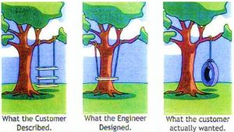
Everyone has the same picture
Two keys to success
With clarity on...
What we are building
What we are not building
We get…
Aligned expectations
Common language
Meaningful estimates

Slide 6
Session #2 agenda
Break
Setting the product vision
Defining your goals
Choosing a strategy
Writing customer promises
Creating a roadmap
Notes:
Today, we’ll talk about several important tools you can use to communicate the outcomes you want to achieve.

Slide 7
Setting the product vision

Slide 8
Why a vision statement is important

Slide 9
A vision statement acts as a north star that motivates and guides your team, conveying the overarching goal your team is aiming for
Notes:
A vision statement is the north star for your product and your team. It is aspirational, it's the reason you're creating this "product," and it points to what is the overarching goal your team is trying to achieve.
It’s important to take the time to get the vision statement right. The goals, strategy, roadmap, backlog, execution, and delivery of your product will all flow from the vision. Every time someone has a question about “should we do this, or that,” or “how important is it to do this,” you will refer back to your vision to help you find the answer.

Slide 10
Your vision statement helps you and your team communicate clearly about the work you’re doing to anyone at any time.
Notes:
Your vision statement lets you quickly and easily tell anyone, at any time, what you’re doing and why they should care.
Everyone can tell the same story with the same passion and conviction (so that you aren’t the communication bottleneck).

Slide 11
And it helps you pitch the value of your product at every stage of the project.

Slide 12
You will revisit and may adjust your vision at times as you learn more, but maintaining a clear, inclusive vision is critical to product success

Slide 13
How to create a vision

Slide 14
A vision statement should answer:
Who are we helping?
What’s the problem?
How are we helping?
What’s the outcome we’re hoping for?
How will this solution be better than others?

Slide 15
Vision statements should be clear, concise, informative and inspirational
Notes:
It's your "elevator pitch" that helps your team communicate clearly about the work you're doing to anyone at any time and galvanize support. Try to stick to 1-3 sentences.

Slide 16
Be aspirational: Where do we want to be in 5 years? 15 years?

Slide 17
A good vision paints a picture of the future that draws people in

Slide 18
Vision statements should be devoid of specific implementation details
Notes:
Focuses on outcomes and objectives, rather than specific implementation details or solutions, and provides strategic direction for the team

Slide 19
We want a world where [some constituent] is able to [get some clear value that is meaningful to them]

Slide 20
What’s your vision?

Slide 21
Get at your vision
What problem are you solving? Why is it meaningful?
Who are your constituents? What’s important to them?
What is your vision? Why is your solution desirable to your constituents?

Slide 22
Washingtonians applying for benefits can find it difficult to keep track of what is supposed to happen next and what additional steps they need to complete, especially if they have multiple applications and enrollments. As a result, it can take them longer to receive their benefits, and they risk having their application denied if they take too long to respond.
What problem are you solving? Why is it meaningful?

Slide 23
We want Washingtonians to have clarity about their application for benefits so that they can more quickly and easily navigate the process and receive their benefits.
Who are your constituents? What’s important to them?

Slide 24
The Eligibility and Enrollment Status Tracker will provide Washingtonians with a self-service, single point of access to understand eligibility and enrollment status across multiple HHS Coalition programs.
What is your vision? Why is your solution desirable to your constituents?
Notes:
Washingtonians currently receive letters by mail … However, it can be hard to keep track of all the papers, and mail can be an unreliable way to reach Washingtonians who don’t have stable addresses or access to mail.
Washingtonians can call the call center to get the status of their application and additional information. However, it can be confusing to know who to call, they sometimes need to speak with multiple people to resolve their questions, and hold times can be very long.

Slide 25
Vision
What problem are you solving? Why is it meaningful? Washingtonians find it difficult to keep track of what is supposed to happen next, and they risk having their application denied if they take too long to respond.
Who are your constituents? What’s important to them? We want Washingtonians to have clarity about their application for benefits so that they can more quickly and easily navigate the process and receive their benefits.
What is your vision? Why is your solution desirable to your constituents? The Status Tracker will provide Washingtonians with a self-service, single point of access to understand eligibility and enrollment status across multiple programs.
Notes:
Not just an IT problem/solution; there can be policy and procedure changes that could also deliver the desired benefit. Ideally, WA is looking at that side of things alongside IT solutions. Product Team will need a way to stay coordinated with anyone working on policy or procedure changes. You don’t want the Product to encode processes that might be changing. And if there’s a process that’s expensive to implement IT-wise, you may want to look at whether it’s really worth keeping as is, or if changes are worth making.

Slide 26
Defining your goals

Slide 27
Why goals are important

Slide 28
Vision, strategy, and tactics
Creating the product strategy
Vision
Strategy
Tactics
The aspiration, the idea
The plan to achieve that aspiration
Ensuring a successful plan execution
Notes:
Once you have a vision, you need to align on how to realize it. Your strategy outlines a plan of action to achieve that vision. It is not every detail of execution, but rather the approach or direction you will take. Goals help you define your strategy. Given the problem you’re trying to solve (why you’re here) and the vision (what you’re trying to do), what are the high-level goals and objectives , the priorities, and the constraints so that everyone can understand the logic behind the strategy you’re pursuing.
Once you’ve set the strategy, you can start to plan the execution details, and the strategy will help you prioritize the work you take on and evaluate your success. The strategy is not written in stone, however. Priorities, available resources, and costs may change. Plan to periodically review the strategy

Slide 29
What do goals mean in today’s world?

Slide 30
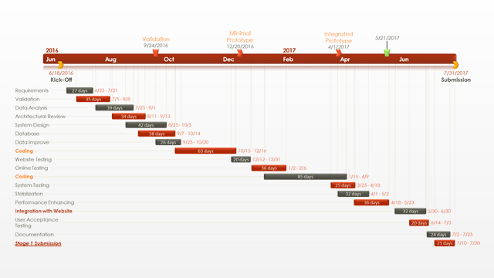

Slide 32
Setting goals isn’t about knowing everything up front and writing it down.
Setting goals means knowing what you’re trying to achieve (and why).

Slide 33
Vision
Goals & Plan
Execution
We should climb a mountain! It will be great!
We should climb this mountain. It has a spectacular view and great campgrounds.
Let’s start hiking up this trail! We’ll find good resting points and adjust our route as we go.

Slide 34
What are your goals?

Slide 35
Goals
Deliver user value.
Validate the Platform.
Make progress towards the IE&E vision.
Notes:
The following desired outcomes have been identified for the Status Tracker project:
Make progress towards the IE&E vision (business outcome)
Validate that the Platform can support a product (technical outcome)
Deliver user value (user outcome)

Slide 36
Goals
Deliver user value. Decrease days to process; reduce calls inquiring about status; reduce duplicate or abandoned applications
Validate the Platform.
Make progress towards the IE&E vision.
Notes:
If an action is required on their part, they will be able to see what next step they need to take in order to progress their application through the process. Instead of being stuck in a step of the process without realizing it, Washingtonians will better understand what is required of them to proceed through the application process. Decrease in days waiting for applicant to provide documents / decrease in time to complete application
Because Washingtonians will be able to follow the status of their application online, they will not call the call center for support unless they prefer to. Washingtonians will have more transparency for eligibility and enrollment activities, which should reduce calls to case workers and contact center staff.

Slide 37
Goals
Deliver user value. Decrease days to process; reduce calls inquiring about status; reduce duplicate or abandoned applications
Validate the Platform. Cloud environments; CI/CD infrastructure; automated testing; API integration layer; authentication and authorization layer
Make progress towards the IE&E vision.
Notes:
According to the draft Platform RFP, the Platform work will encompass setting up cloud hosting; CI/CD infrastructure that includes tools for automated scanning, testing, code promotion, and approvals; an authorization and authentication layer; an API integration layer / gateway; relational databases; and container management, among other things. Quality assurance is expected to include the following implications for the Product 1 Team:
Decreased time and energy to begin new work
Lightweight, repeatable deploy process using CI/CD
With no system downtime
With ability to immediately roll back changes to the last working deployment if necessary
With independence (no infrastructure team involvement)
Environments (e.g., dev, test, staging, prod) have parity
Automated testing throughout
99% monthly uptime
Clear, usable system documentation

Slide 38
Goals
Deliver user value. Decrease days to process; reduce calls inquiring about status; reduce duplicate or abandoned applications
Validate the Platform. Cloud environments; CI/CD infrastructure; automated testing; API integration layer; authentication and authorization layer
Make progress towards the IE&E vision. Tell their story once; mobile-friendly interface; optimized for accessibility; intuitive; replacing ACES
Notes:
According to the IE&E Roadmap, the IE&E vision describes a world where Washingtonians tell their story one time as the new system and underlying business processes securely guide them through the possibilities.
According to the IE&E Roadmap and Decision Package, user value includes providing Washingtonians with easy access to a mobile-friendly interface that is optimized for accessibility and is intuitive to use.
The new experience will be user-friendly and intuitive. Washingtonians will be able to check and act on the status of their application without having to watch an online tutorial to understand how to use the system.

Slide 39
Choosing a strategy
Notes:
Now that you know what your goals are, how do you plan to achieve them? What approach will you take?

Slide 40
The choice of approach impacts your goals
Stand-alone Status Tracker
Status Tracker as a possible foundation for a self-service portal
Status Tracker as a consumable service embedded into WACONN, HPF, IVR, etc
Notes:
One key element of your strategy that we uncovered is deciding on a technical approach to building the status tracker. There are multiple ways you could go about building this product, and each has different implications for achieving your goals.

Slide 41
The choice of approach impacts your goals
Stand-alone Status Tracker
Status Tracker as a possible foundation for a self-service portal
Status Tracker as a consumable service embedded into WACONN, HPF, IVR, etc
Notes:
In all approaches, users will be able to access the same/similar data. However, the new front end approach better positions Washington to make progress towards the IE&E vision, which includes an intuitive, accessible, mobile-first user experience and a development platform that enables ACES replacement. The consumable service approach would not make sufficient progress towards creating the desired IE&E experience or towards validating and refining the technical approach to replacing ACES and thus would leave Washington only marginally better off after Year 1 than currently. See Assessment for more details.

Slide 42
Writing customer promises / user stories
Notes:
We have goals, strategy. What might execution look like?

Slide 43
Why customer promises are important

Slide 44
Now that we understand the vision and strategy, let’s look at the end user experiences that enable it. These are the customer promises.
Notes:
We have a vision statement that tells you where you want to go and why, and we have a strategy that tells us the direction you want to go, but we haven’t really described how you plan to get there.
What do you plan to do to deliver on your vision?

Slide 45
Every piece of work that anyone on the project does, no matter how big or small, must somehow support your customer promises.

Slide 46
How to define customer promises

Slide 47
Defining customer promises
What are the core components of your vision?
Who are your end users?
What do they want to use your product to do?
Notes:
What are the core components of your vision? Think in terms of services that you can provide to your end users.
Who are your end users? Do you have more than one group? What do they want to use your product to do? These high level workflows are your customer promises.
Who are your stakeholders? What do they want your product to do? How does that affect your end users?

Slide 48
Defining customer promises
What are the core components of your vision? Self-service, single point of access, application status, next steps
Who are your end users?
What do they want to use your product to do?
Notes:
What are the core components of your vision? Think in terms of services that you can provide to your end users.
Who are your end users? Do you have more than one group? What do they want to use your product to do? These high level workflows are your customer promises.
Who are your stakeholders? What do they want your product to do? How does that affect your end users?

Slide 49
Defining customer promises
What are the core components of your vision? Self-service, single point of access, application status, next steps
Who are your end users? Stressed, busy, web access via mobile devices, aged, blind, disabled, low English proficiency, low tech proficiency, no stable address, need assistance
What do they want to use your product to do?
Notes:
What are the core components of your vision? Think in terms of services that you can provide to your end users.
Who are your end users? Do you have more than one group? What do they want to use your product to do? These high level workflows are your customer promises.
Who are your stakeholders? What do they want your product to do? How does that affect your end users?

Slide 50
Defining customer promises
What are the core components of your vision? Self-service, single point of access, application status, next steps
Who are your end users? Stressed, busy, web access via mobile devices, aged, blind, disabled, low English proficiency, low tech proficiency, no stable address, need assistance
What do they want to use your product to do?
See story map
Notes:
What are the core components of your vision? Think in terms of services that you can provide to your end users.
Who are your end users? Do you have more than one group? What do they want to use your product to do? These high level workflows are your customer promises.
Who are your stakeholders? What do they want your product to do? How does that affect your end users?

Slide 51
Using story mapping to identify user needs
What are the most central tasks that must be accomplished in getting the job done? What abilities do the users need?
When does the user need this functionality? What is the workflow? What happens right before? What happens right after?
How will these abilities/info interact with other abilities/systems?
Notes:
Define the execution step: what are the most central tasks that must be accomplished in getting the job done?
Define pre-execution steps: what must happen before the core execution step to ensure the job is successfully carried out?
Define post-execution steps: what must happen after the core execution step to ensure the job is successfully carried out?

Slide 52
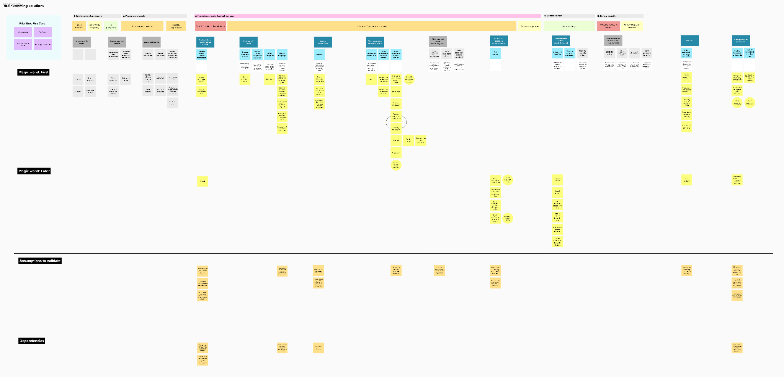

Slide 53
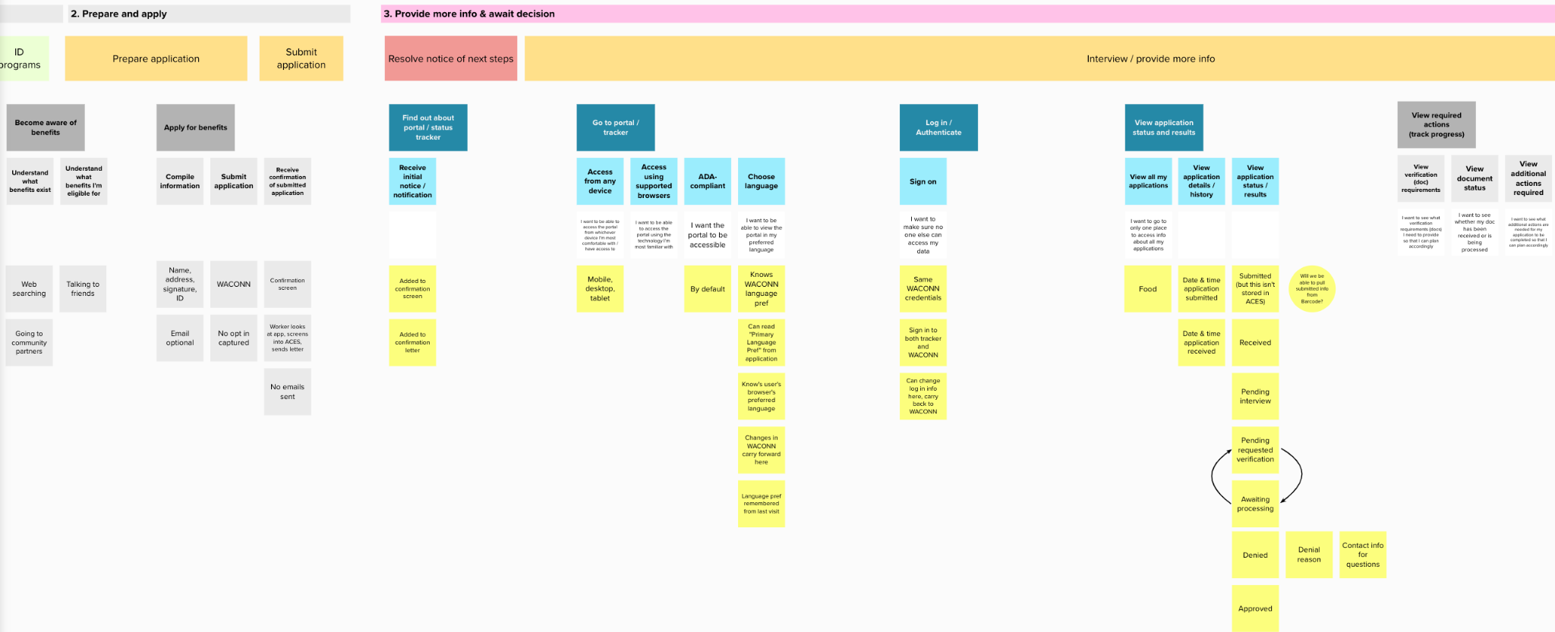
Notes:
Update to show status tracker story map

Slide 54
How to write customer promises
Notes:
Now that we’ve identified who are users are and what they need, how do we communicate that?

Slide 55
As a [type of user],
I want [this ability / functionality]
so that [this benefit / value]
User story format
Notes:
User stories are a format to help you communicate desired functionality
The User Story tells everyone working on the project 3 key things:
WHO you’re solving this problem for -- can leverage user roles or user personas for this
WHAT functionality you want to enable
WHY that functionality is important

Slide 56
Invitation to a conversation
From a user’s perspective
Describes What, not How
Plain, concise language with a common format
Can be written at varying levels of detail
Benefit of user story format
Notes:
https://www.mountaingoatsoftware.com/agile/user-stories
https://www.freecodecamp.org/news/how-and-why-to-write-great-user-stories-f5a110668246/
https://www.mountaingoatsoftware.com/blog/advantages-of-the-as-a-user-i-want-user-story-template

Slide 57
Independent - Stories can be worked on in any order, independently of other stories
Negotiable - The solution and requirements are not prescribed by the story, only the desired goal. The approach is open to discussion and collaboration
Valuable - The value of the story, the “why,” is clearly articulated
INVEST to write good user stories
Notes:
https://www.berteig.com/how-to-apply-agile/summary-of-user-stories-the-three-cs-and-invest/
I – Independent
The solution can be implemented by the team independently of other stories. The team should be expected to break technical dependencies as often as possible – this may take some creative thinking and problem solving as well as the Agile technical practices such as refactoring.
N – Negotiable
The scope of work should have some flex and not be pinned down like a traditional requirements specification. As well, the solution for the story is not prescribed by the story and is open to discussion and collaboration, with the final decision for technical implementation being reserved for the Development Team.
V – Valuable
The business value of the story, the “why”, should be clearly understood by all. Note that the “why” does not necessarily need to be from the perspective of the user. “Why” can address a business need of the customer without necessarily providing a direct, valuable result to the end user. All stories should be connected to clear business goals. This does not mean that a single user story needs to be a marketable feature on its own.
E – Estimable
The team should understand the story well enough to be able estimate the complexity of the work and the effort required to deliver the story as a potentially shippable increment of functionality. This does not mean that the team needs to understand all the details of implementation in order to estimate the user story.
S – Small
The item should be small enough that the team can deliver a potentially shippable increment of functionality within a single Sprint. In fact, this should be considered as the maximum size allowable for any Product Backlog Item as it gets close to the top of the Product Backlog. This is part of the concept of Product Backlog refinement that is an ongoing aspect of the work of the Scrum Team.
T – Testable
Everyone should understand and agree on how the completion of the story will be verified. The definition of “done” is one way of establishing this. If everyone agrees that the story can be implemented in a way that satisfies the current definition of “done” in a single Sprint and this definition of “done” includes some kind of user acceptance test, then the story can be considered testable.
https://agileforall.com/new-to-agile-invest-in-good-user-stories/
Independent: Stories should be as independent as possible. When thinking of independence it is often easier to think of “order independent.” In other words, stories can be worked on in any order. Why is this important? It allows for true prioritization of each and every story. When dependencies come into play it may not be possible to implement a valuable story without implementing other much less valuable stories.
Negotiable: A story is not a contract. A story IS an invitation to a conversation. The story captures the essence of what is desired. The actual result needs to be the result of collaborative negotation between the customer (or customer proxy like the Product Owner), developer and tester (at a minimum). The goal is to meet customer needs, not develop something to the letter of the user story if doing so is insufficient! Remember, you can always ask the magic question to help drive the conversation.
Valuable: If a story does not have discernable value it should not be done. Period. Hopefully user stories are being prioritized in the backlog according to business value, so this should be obvious. Some people say each story should be valuable to the customer or user. I don’t like that way of thinking because business value encompasses more than just customer or user facing value. It includes internal value which is useful for things which are normally called “non-functional requirements” or something similar. I prefer to say the story has value to the “user” in the user story. In this way it is clear who is to be satisfied. Finally, remember the “so that <value>” clause of the user story. It is there for a reason – it is the exact value we are trying to deliver by completing the story!
Estimable: A story has to be able to be estimated or sized so it can be properly prioritized. A value with high value but extremely lengthy development time may not be the highest priority item because of the length of time to develop it. What happens if a story can’t be estimated? You can split the story and perhaps gain more clarity. Sometimes splitting a story doesn’t help though. If this situation occurs it may be necessary to do some research about the story first. Please, please, please timebox the research! If you do not, it will take all available time thereby depriving the product of something else which could have been done instead.
Small: Obviously stories are small chunks of work, but how small should they be? The answer depends on the team and the methodology being used. I teach agile and suggest two week iterations which allow for user stories to average 3-4 days of work – TOTAL! This includes all work to get the story to a “done” state. Also remember not to goldplate user stories. You should do the simplest thing that works – then stop!
Testable: Every story needs to be testable in order to be “done.” In fact, I like to think of testable meaning acceptance criteria can be written immediately. Thinking this way encourages more collaboration up front, builds quality in by moving QA up in the process, and allows for easy transformation to an acceptance test-driven development (ATDD) process. As with negotiable above, asking the magic question can help ensure the user story is testable as well.

Slide 58
The user story format is simple,
but it takes practice to do well
Notes:
https://agilepainrelief.com/notesfromatooluser/2019/01/deal-with-bad-scrum-user-stories-as-a-scrummaster.html#.XekmHZJKhuM

Slide 59
The “so that” should not repeat the “I want”
Examples
Weak
As a customer reserving a hotel, I want to locate previous reservations so that I can see all the reservations I’ve made
Stronger
As a customer reserving a hotel, I want to see my past reservations so that I can rebook the same hotel, saving me time and effort searching for hotels again
Notes:
Measurable outcome
Goal that opens up discussion on the What
https://agilepainrelief.com/notesfromatooluser/2019/01/deal-with-bad-scrum-user-stories-as-a-scrummaster.html#.XekmHZJKhuM

Slide 60
The user should be appropriately specific
Examples
Weak
As a customer, I want to locate previous reservations so that I can see all the reservations I’ve made
Stronger
As a customer who travels to the same site repeatedly and needs to reserve a hotel, I want to locate previous reservations so that ...
Notes:
https://agilepainrelief.com/notesfromatooluser/2019/01/deal-with-bad-scrum-user-stories-as-a-scrummaster.html#.XekmHZJKhuM

Slide 61
The “I want” should not be prescriptive
Examples
Weak
As a customer who travels to the same site repeatedly, I want to see a list of previous reservations in a yellow box at the top of the screen so that …
Stronger
As a customer who travels to the same site repeatedly, I want my previous reservations to be easily referenceable so that ...
Notes:
https://agilepainrelief.com/notesfromatooluser/2019/01/deal-with-bad-scrum-user-stories-as-a-scrummaster.html#.XekmHZJKhuM

Slide 62
What are your customer promises?
Notes:
So the vision, the goals, the strategy: what we shared here today is going to form the Scope for the RFP. This is the heart of what you’re telling prospective vendors you want them to work on. You can’t make a change here without changing the contract. So it’s important to be aligned.
The rest of what we’re talking about: the customer promises or user stories, the roadmap: these will also go into the RFP, but they’re meant to provide some indication of what your intentions are. You’ll include language that says they’re for illustrative purposes only, so that you retain the flexibility to adjust which specific features you want them to focus on and in what order, without having to change the contract.
But even though you have flexibility, you want to provide an accurate picture of what you’re expecting so the vendor can provide you with a reliable estimate of cost and personnel needed.
We hope to have at the end of this time approved initial user stories and a roadmap for inclusion in the RFP

Slide 63
As a Washingtonian who has applied for benefits, I need to find out about the tracker so that I know how to check the status of my application
As an applicant or client, I need to be notified of updates and announcements relevant to me so that I can effectively manage my benefits
As an applicant, I need to be able to sign on once to access all my applications so that I can save time and confusion from going to multiple sites or remembering multiple logins
Accessing the site
Notes:
What will the vendor be responsible for here?
Updates to existing comms to include links to status tracker?
Email service to send automated emails?
Push notification service to send automated text messages?
Authentication and authorization: integrate with SAW directly, with a new auth tool, or with the platform?
Discussion
Email and text, push notifications
Nicole: Early on, we did talk about potential text messaging and push notifications. Whether or not it got any traction, I don’t know. Both a goal for IE overall and status tracker in particular.
Cathie: HPF uses texting for MAGI clients
Kim: For DSD it would be new, we’re not currently doing this
Nicole: Telephony, predictive dialer technology available? Kim: There are campaigns we could probably utilize
Thanh: We do send letters (from ACES perspective) – award letters, app pending. Can inform through those channels.
Monika: It’s most likely there will be a need for push notifications beyond status tracker, should probably be part of the platform, but don’t know
Debbie F: Need program view over program view. Aligning with what Monika is saying. There needs to be an early discussion of this need and then figure out what scope this needs to land in. Probably not Product. There are also convos around IVR replacement and what that could look like.
Nina: I’d recommend then that this not be part of this RFP
Debbie: Nicole, do you have concerns with this being out of scope for this product?
Nicole: We have to know what the scope of this project is, and there are always concerns about scope creep. Would like to hear from business SMEs based on what customer needs.
Dana: Important to try to get an early win, so keeping coding effort lower.
Doug: Design principles that would allow for future functionality. My head is spinning with foundational things that Product 1 may or may not use. The design of the database. All these things that potentially impact the future, but we also need to move quickly.
SAW integration
Debbie: I see a couple indiviuals who could weigh in. I think probably integrate with the platform. David A, Kelly, can you weigh in?
David: SAW is an abstraction. Run by WATECH.
Dan R: Will Product 1 be its own service in SAW, and other future products will get their own services, or register a master service?
David: Product 1 vendor would be responsible for SAW integration.
Debbie: Ah, I was assuming there’d be more of a master.
Nina: Let’s continue this offline
Monika: Preference would be for platform to do it. We need to know whether that’s possible or not. That will be offline discussion

Slide 64
As an applicant who relies on a mobile device for internet access, I need to be able to access the tracker from my cell phone, not just a desktop or tablet, so that I can use the site
As an applicant who is aged, blind, or disabled, I need the site to be accessible so that I can use the site
As an applicant whose first language is not English, I need the site to support multiple languages so that I can use the site
Using the site
Notes:
What will the vendor be expected to be responsible for here?
Language support and translation, or will that be provided by the platform?
Discussion
Monika: We don’t have a team that does that already, but we have resources we use when we need to do that work.
David: Might be able to split it up. Set up localization framework could be done by vendor, look within DSHS for the language.

Slide 65
As an applicant, I need to view the status / result of my application so that I understand where I am in the process and what to expect
As an applicant, I want to group my applications based on whether they are pending, active, denied, or under recertification so that I can easily understand what’s happening across all my applications
As an applicant, I need to view what documents I need to provide and the status of documents I’ve already provided so that I can tell if I need to do anything to process my app
As an applicant, I need to view any additional actions I need to take and my progress so that I can tell if I need to do anything to process my app
As a client who needs to recertify, I need to see what information I need to provide, when, the status, and the results so I can continue to receive needed benefits without interruption
Viewing status

Slide 66
As a client who is enrolled in benefits, I need to see what benefits I’m receiving and how to access them, as well as how much time and/or funds I have left so that I can plan my budget
As a client, I need to see a history of previous benefit issuances/premiums/cost of care so that I can understand any changes that are made
Viewing benefits
Notes:
Does it make sense that seeing the benefits you received is part of seeing the status or results of your application?
Would you want any of this info to be taken down from WACONN CBA once it’s online here?
Discussion
Monika: Within scope but lower priority

Slide 67
As an applicant, I need to be able to authorize a representative to assist me so that I can get help managing my application
As an applicant viewing my status, I need to view copies of documents I received related to my application so that I can still reference them in case I lose track of them
As an applicant viewing my status, I need to know what options I have for troubleshooting so that I can follow up in case I have questions
As an applicant viewing viewing my status, I need to know where to go to complete application- and account-related tasks that are not supported by the tracker so that the experience feels less confusing and fragmented
Getting help
Notes:
Viewing documents – we’re aware of a complication here. Are there plans to address that elsewhere? Is this vendor expected to solve that?
Discussion
Nicole: I was not expecting document uploads to be part of scope. Or downloads.
Dan: I think that’s part of a later product.

Slide 68
A staff-facing portal for status tracking
Document uploading
NOT IN SCOPE
Notes:
Pause to validate, discuss ambiguity around intentions beyond Year 1 and what RFP should cover
Discussion
Dana: Staff need to be able to see it.
Kydee: The idea is that it pulls info from ACES, which is the system they already use, so they already have access.
Dana: Someone might get frustrated that we’re not able to see what they’re able to see.
Nina: Who to include in this decision?
Dana: Folks who are providing staff support. Andre and Alice?
Dana: Roadmap uses language about eligibility workers and applicants having the same access.
Nina: We can include this as a possible user story in the RFP, and you can make this decision later

Slide 69
Creating a roadmap
Notes:
Once you have customer promises, what do you do with them?

Slide 70
Why roadmaps are important

Slide 71
Roadmaps contain:
Customer promises that are broken down into bite sized chunks of work, prioritized, and set on an estimated timeline.
Notes:
We have all these customer promises. How are we going to tackle this list? We can’t do it all at once, so how are we going to start?
Write customer promises
Prioritize promises
Group promises
Sequence promises
Break promises into tasks
Break tasks into user stories

Slide 72
The roadmap is a bridge between your strategic vision and your backlog of work. They help you keep track of the big picture and correlate every work item to your end goal.
Notes:
It serves as a bridge between your strategic vision and your backlog of work. It helps you keep track of the big picture and tie every piece of work to your end goal.

Slide 73
The roadmap also helps you stay aligned with your stakeholders.
Notes:
Drive alignment on expected outcomes and functionality (how we’ll know if we solved the problem)

Slide 74
You shouldn’t use roadmaps to forecast exactly what will get delivered when. They’re for planning the order in which you’ll tackle the various pieces of the overarching problem.

Slide 75
You shouldn’t use roadmaps to forecast exactly what will get delivered when. They’re for planning the order in which you’ll tackle the various pieces of the overarching problem.

Slide 76
Roadmaps are not a promise.
They are a statement of intent.

Slide 77
Examples of roadmaps

Slide 78
There are many ways to create a roadmap. Here are a few examples that communicate timelines.

Slide 79
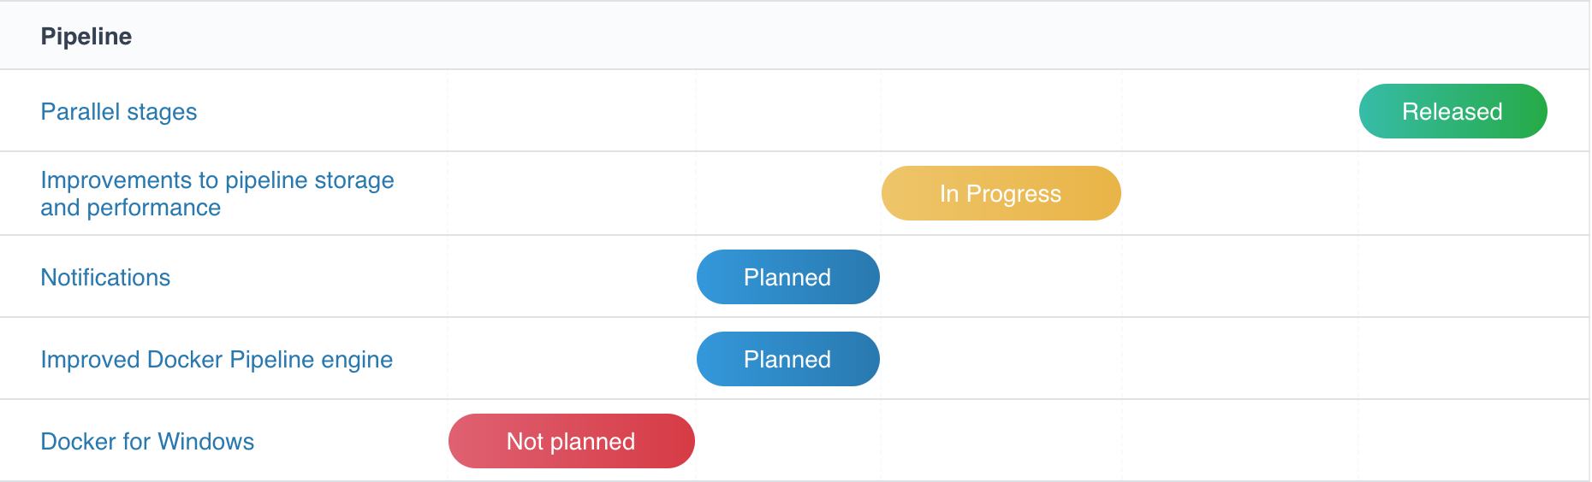
List-style Roadmap
This general timeline keeps dates vague but still shows where things currently are
Details can be viewed by clicking through to another level
Notes:
To explore more: https://jenkins.io/projects/blueocean/roadmap/

Slide 80
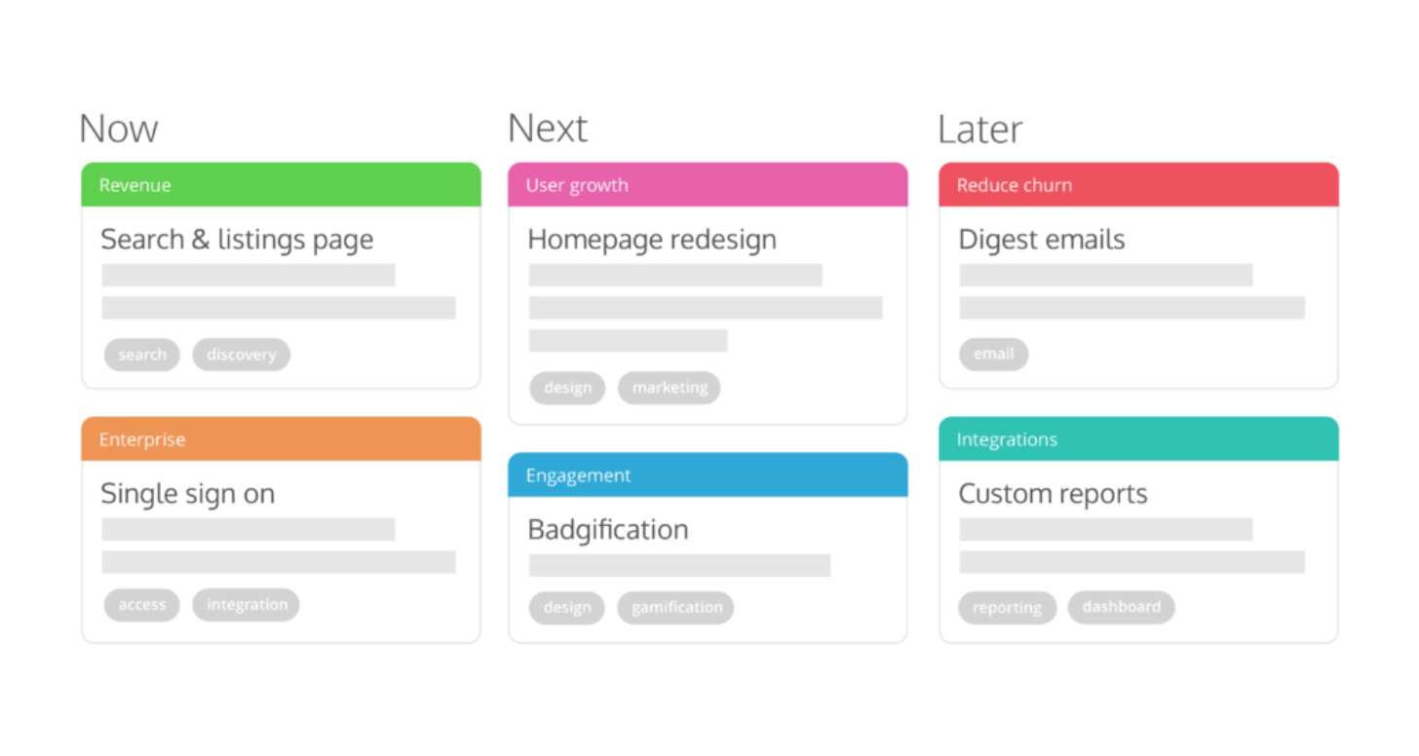
Theme-based Roadmap
Multiple themes can be worked on at one time.
Bite-sized chunks of work are tied back to large themes.
There are indicators of which teams will be doing the work
Notes:
To learn more:

Slide 81
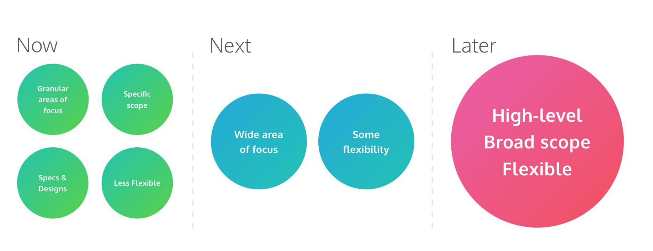
Theme-based Roadmap
Notes:
To learn more: https://www.prodpad.com/blog/how-to-build-a-product-roadmap-everyone-understands/

Slide 82
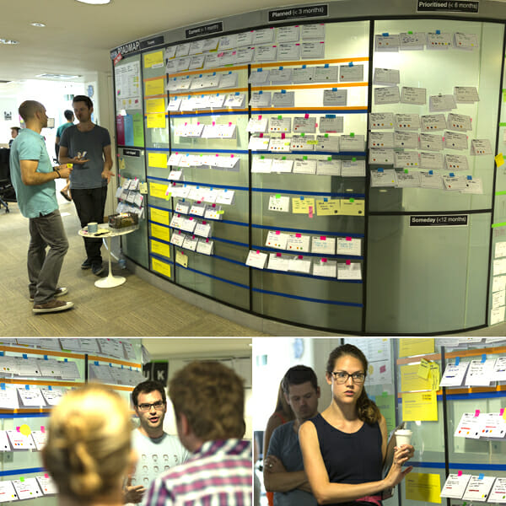
Timeline + Team Swimlane Roadmap
Swimlanes indicate which team will do the work
Prioritized work is put into specific time periods (1 month, 3 months, 6 months) based on confidence and size
There is a section for unprioritized work
Notes:
To learn more visit: https://www.mindtheproduct.com/2014/07/experiments-roadmapping-gov-uk/

Slide 83
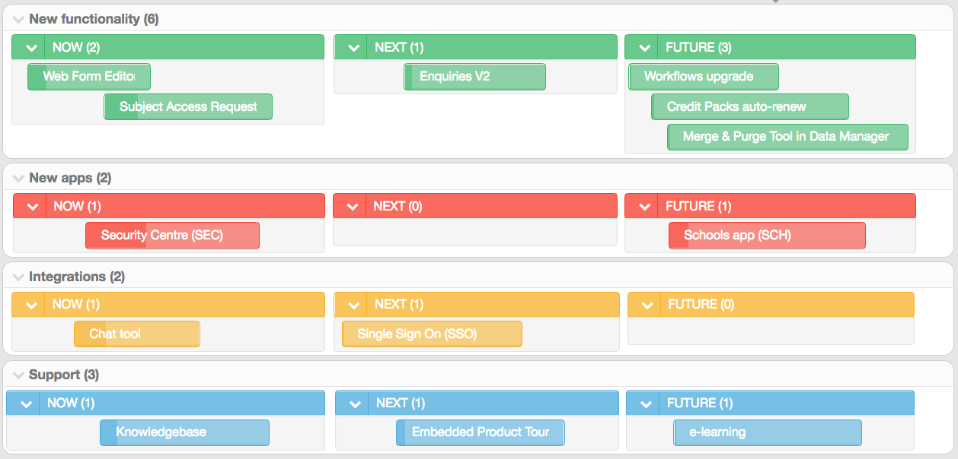
Timeline + Theme roadmap
See the evolution of multiple themes over a general timeline
Understand progress at a glance
Helps break things out into value-driven releases
Notes:
To learn more: https://www.student-crm.co.uk/roadmap/
Some version of this is what I’d recommend for IE&E

Slide 84
How to create a roadmap: Defining chunks of work

Slide 85
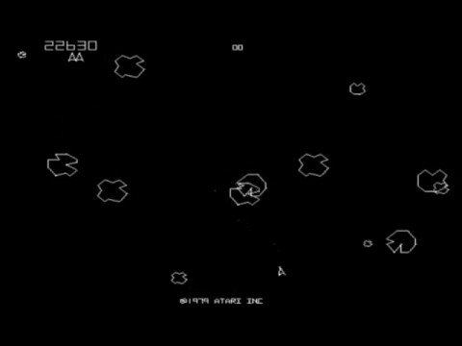
Notes:
Watch a few minutes of this.
So, what’s the right approach for playing Asteroids?
Strategy one: First break up all the big rocks, then break up all the mid-sized rocks, then shoot all the small rocks.
What’s the downside? Too much chaos, too many things can go wrong… and that’s not even including the unpredictable alien spaceship (on no, a failed procurement)!
Stategy two: One big rock broken down at a time, to completion, then start on the next big rock.
Not only do you maintain control and reduce your blood pressure, but it’s easier to take on the unpredictable and maybe even see it as an opportunity!

Slide 86
By doing this...
Break down a problem iteratively
Break large chunks into medium ones, medium chunks into small ones, and so on
Do not break large chunks into small ones
Provide more detail as a project matures
We can…
Focus
Avoid doing too many things at once
Estimate more accurately
Create a sensible build plan that delivers value continuously, not just at the end

Slide 87
Example
Make a cake that can feed 500 people
How will you do it?
How long will it take?
How much flour, sugar, etc will you need?
Make 10 3-tier cakes that each feed 50 people
I know how to make a 3-tier cake
I know how long that takes and what ingredients I need
I can create a plan
Even if I don’t finish, we’ll still have some cake

Slide 88
Focus on criteria that could have significant impact on estimates or timelines or user value

Slide 89
There may be multiple ways of breaking down the problem and defining chunks of work.

Slide 90
Example
Cake for 500
10 3-tier cakes or 3 5-tier cakes?
1 cake at a time or 1 layer at a time?
Start with top layer or bottom layer?
What flavors?

Slide 91
Functionality
Defining chunks of work
Apply for benefits
Submit application
Recertify
Upload documents
Understand application status
View their status
Find out what additional information or actions are required
Download documents
View benefits
View details about benefits they are receiving (amount, period, etc)
View previous benefits
Manage account
Manage their account information
Communicate securely with agency staff
Receive notifications and alerts
Notes:
In the next section, we’ll prioritize these. Figure out what’s in scope and what’s out, what comes first and what comes later.

Slide 92
Use cases
Defining chunks of work
Programs
Classic Medicaid
Food
Cash
Email status
With email
Without email
Application source
Online
Paper
Phone
User type
Self
Authorized representative
Helper
Notes:
In the next section, we’ll prioritize these. Figure out what’s in scope and what’s out, what comes first and what comes later.

Slide 93
How to create a roadmap: Prioritizing

Slide 94
Which customer promises do you need to knock out of the park? Which ones just need to get done? Which ones are nice-to-haves?

Slide 95
Then think about timing. There are customer promises that naturally fit together, because they rely on shared infrastructural work. Even if they’re different priority levels, it makes sense to group them.

Slide 96
Then think about timing. There are customer promises that naturally fit together, because they rely on shared infrastructural work. Even if they’re different priority levels, it makes sense to group them.

Slide 97
Then think about timing. There are customer promises that naturally fit together, because they rely on shared infrastructural work. Even if they’re different priority levels, it makes sense to group them.

Slide 98
What do we need now and what can we do later?
What can we simplify for now?

Slide 99
You can use that to create a rough roadmap for your product. Try not to have too many customer promises in play at any one time — your team needs to be able to keep track of what promises they’re working on!

Slide 100
You can use that to create a rough roadmap for your product. Try not to have too many customer promises in play at any one time — your team needs to be able to keep track of what promises they’re working on!

Slide 101
Remember:
Every piece of work that anyone on the project does, no matter how big or small, must somehow support your customer promises.

Slide 102
What’s your roadmap?

Slide 103
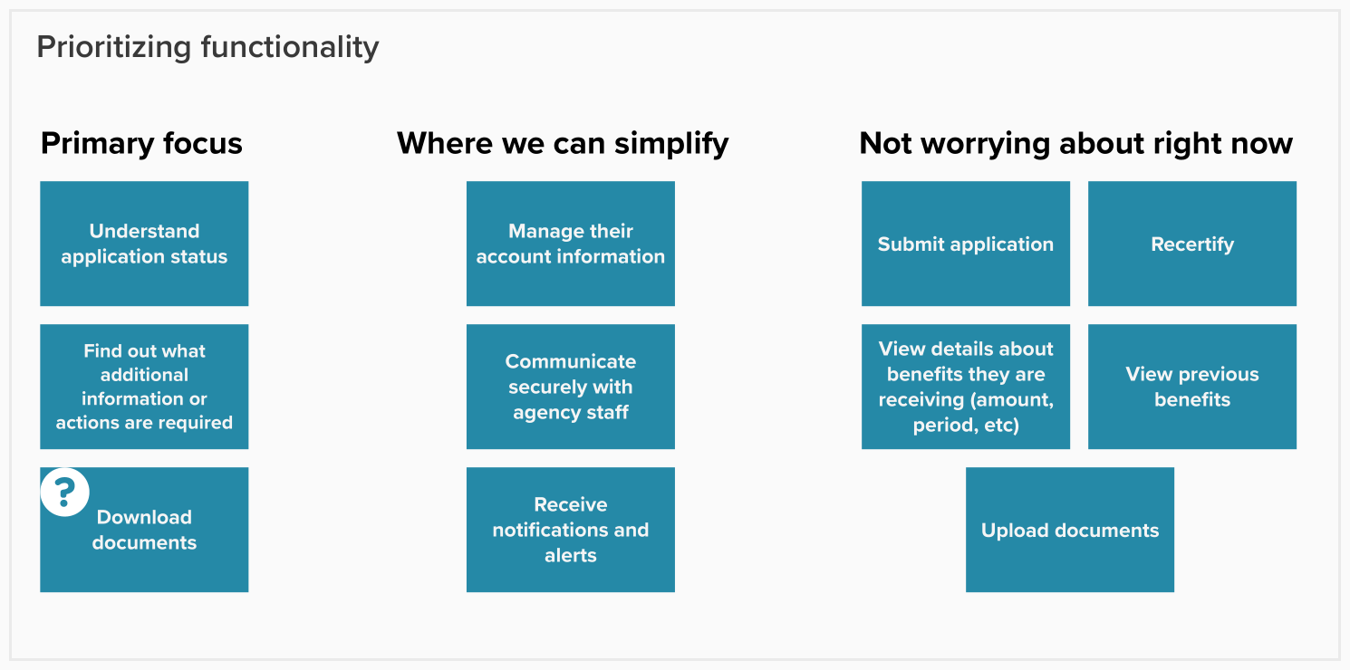
Notes:
Will out-of-scope features (e.g., doc downloads and push notifications) be part of RFP or separate?
Will other portal features (e.g., application) be part of RFP or separate? (Rec separate)

Slide 104
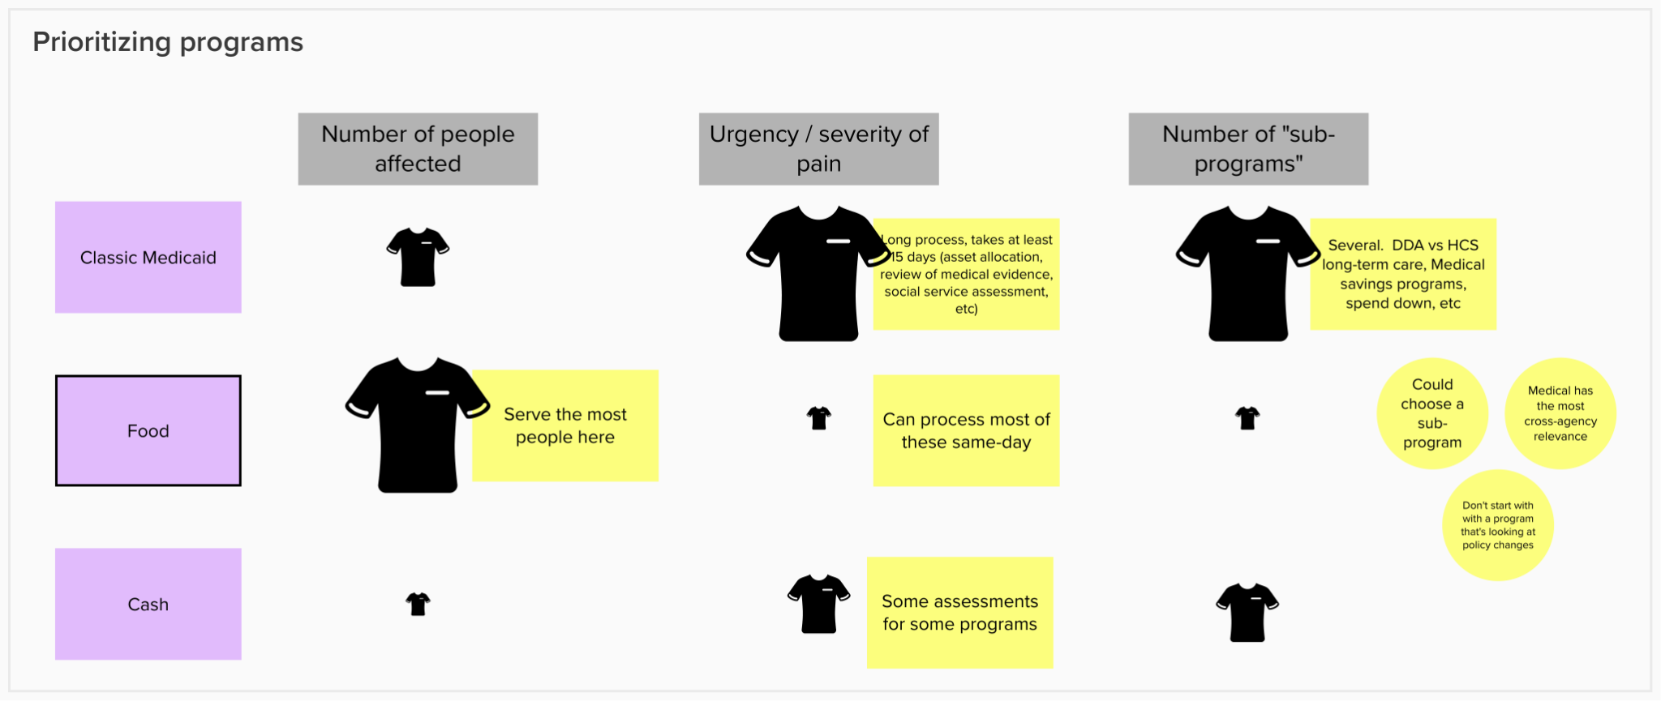

Slide 105
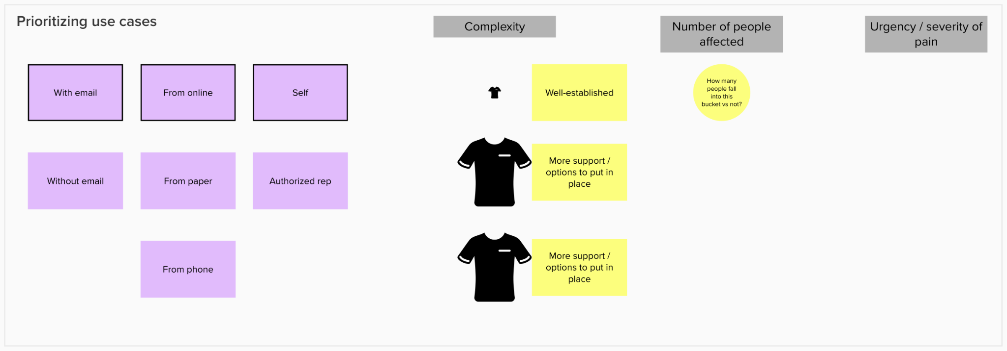

Slide 106
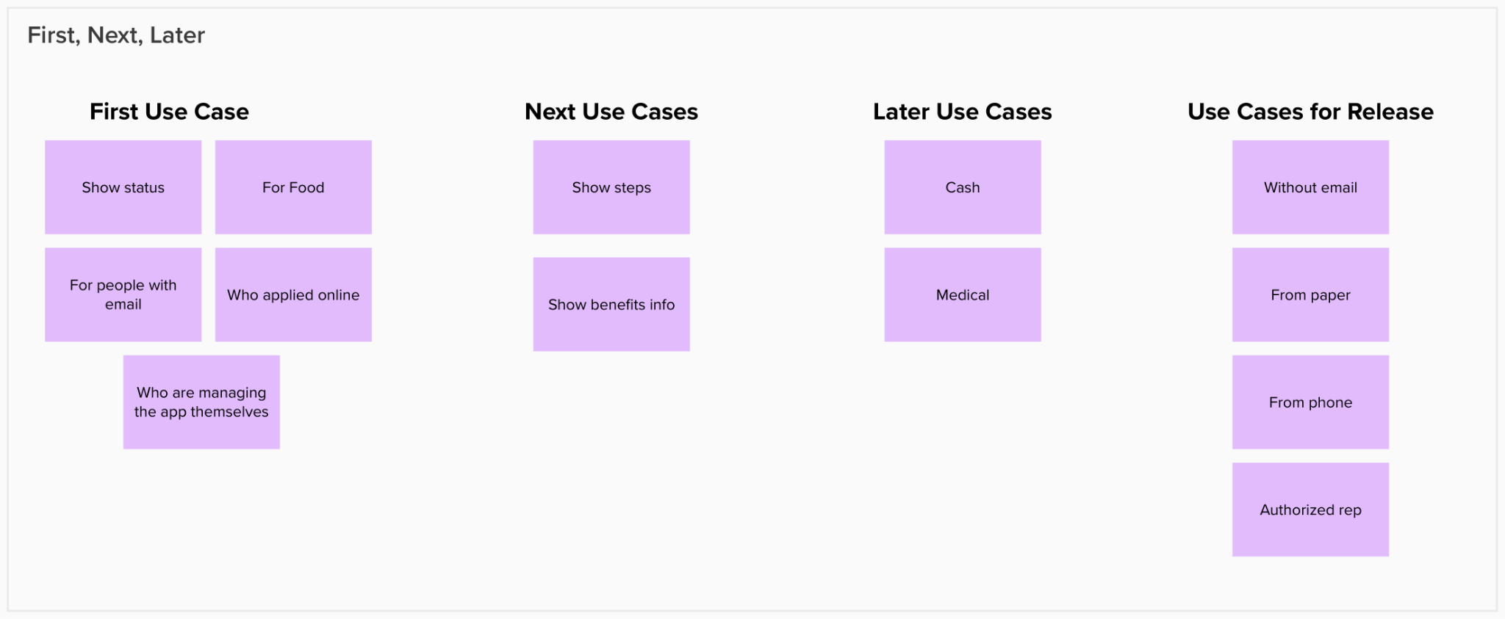
Notes:
MVP / Release plans (don’t need to decide until you get to the “later” stories around making the status tracker release-ready)

Slide 107
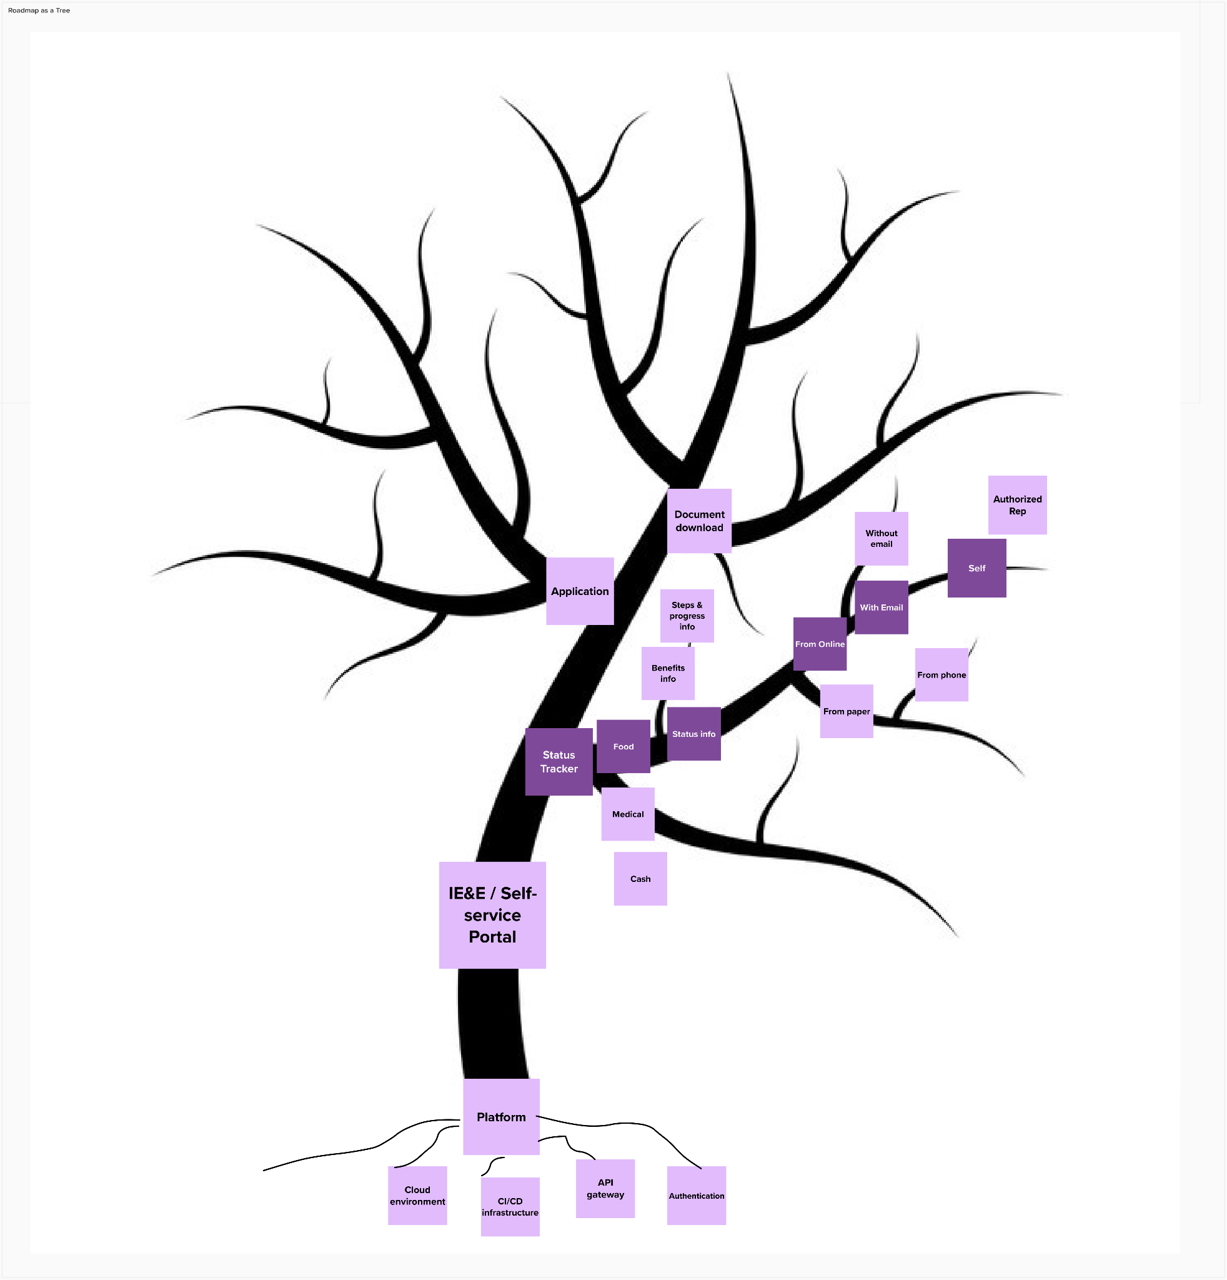
Roadmap as a Tree

Slide 108
Questions Discussion

